Slide 1

Group 22
Fetal health classification
Sahil Arora;
Mario Gonzalez;
Wang, Liyao;
Mahika Bansal
Aug 2021

Slide 2
1
Introduction
2
Preliminary Analysis
Content
3
Modelling and Predictions
4
Insights and Implications

Slide 3
01
Introduction

Slide 4
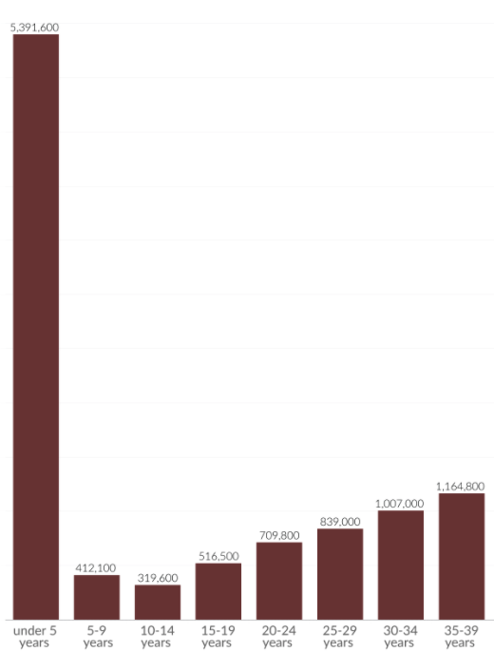
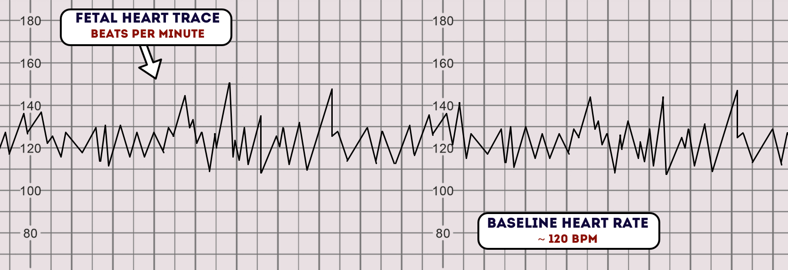
INTRODUCTION
UNDERSTANDING CTG RESULTS AND IDENTIFICATION OF PATHOLOGICAL CASES CAN HELP REDUCE CHILD MORTALITY RATES
Deaths Globally by Age
Highlights
~67% deaths:
among children under age five, newborns are the most vulnerable age group
Regions:
most severely affected:
Sub-Saharan Africa, South-Eastern Asia, South America
Maternal mortality: another associated concern, out of which 94% could have been prevented with better resources
The death toll for the very youngest age-group
(under 5 years)
stand out
1
2
3
Sample CTG Interpretation
Cardiotocograms (CTGs) help in analyzing fetal health with information on
Fetal heart rate (FHR),
Fetal movements,
Uterine contractions
Source: Our World in Data; Geeky Medics; https://www.un.org/development/desa/pd/sites/www.un.org.development.desa.pd/files/unpd_2020_levels-and-trends-in-child-mortality-igme-.pdf

Slide 5
Key Question:
How can we help reduce child mortality rates with the available technology?
AIM:
Assessment of various parameters of a Cardiotocogram (CTG) exams
(2126 observations across 20+ variables; source: kaggle)
Prediction of problematic fetal health (“suspect”) cases
INTRODUCTION
UNDERSTANDING CTG RESULTS AND IDENTIFICATION OF PATHOLOGICAL CASES CAN HELP REDUCE CHILD MORTALITY RATES
Deaths Globally by Age
Highlights
67% deaths:
among children under age five, newborns are the most vulnerable age group
Regions:
most severely affected:
Sub-Saharan Africa, South-Eastern Asia, South America
Maternal mortality: another associated concern, out of which 94% could have been prevented with better resources
The death toll for the very youngest age-group
(under 5 years)
stand out
1
2
3
Sample CTG Interpretation
Cardiotocograms (CTGs) help in analyzing fetal health with information on
Fetal heart rate (FHR),
Fetal movements,
Uterine contractions
...
Source: Our World in Data; Geeky Medics; https://www.un.org/development/desa/pd/sites/www.un.org.development.desa.pd/files/unpd_2020_levels-and-trends-in-child-mortality-igme-.pdf

Slide 6
02
Preliminary Analysis

Slide 7
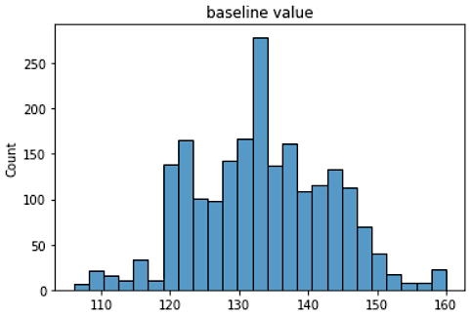
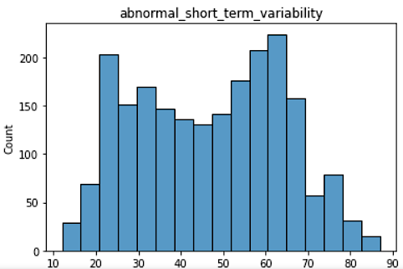
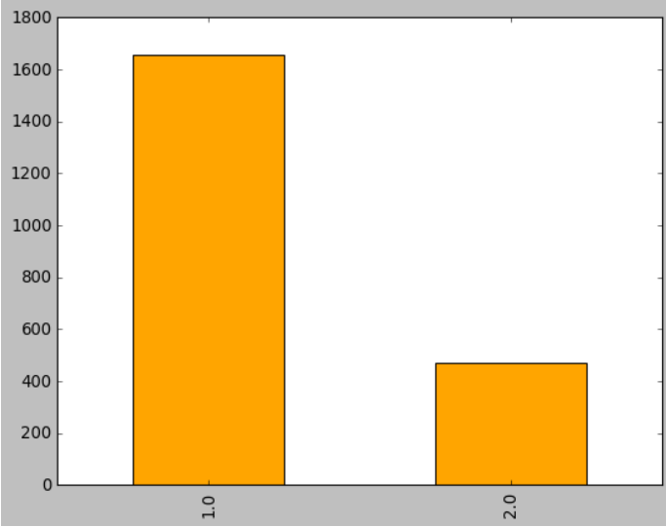
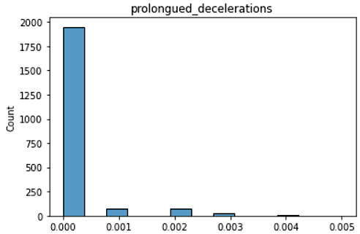
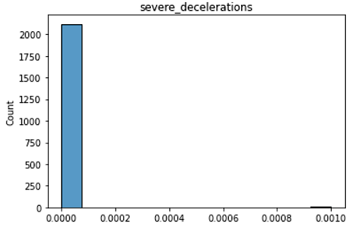
PRELIMINARY ANALYSIS
UNIVARIATE ANALYSIS
Parameters analysed:
Fetal health rate: base line, accelerations & decelerations, variability, fetal heart rate pattern over time (using histogram analysis)
Fetal movement
Uterine contractions
Variables as baseline value, abnormal short-term variability spread across a bigger interval
Fetal health Identification
There seems to be a 77-23 split between normal and suspect cases
Variables as prolongued/
severe decelarations which reflect abnormalities have been rarely non-zero​

Slide 8
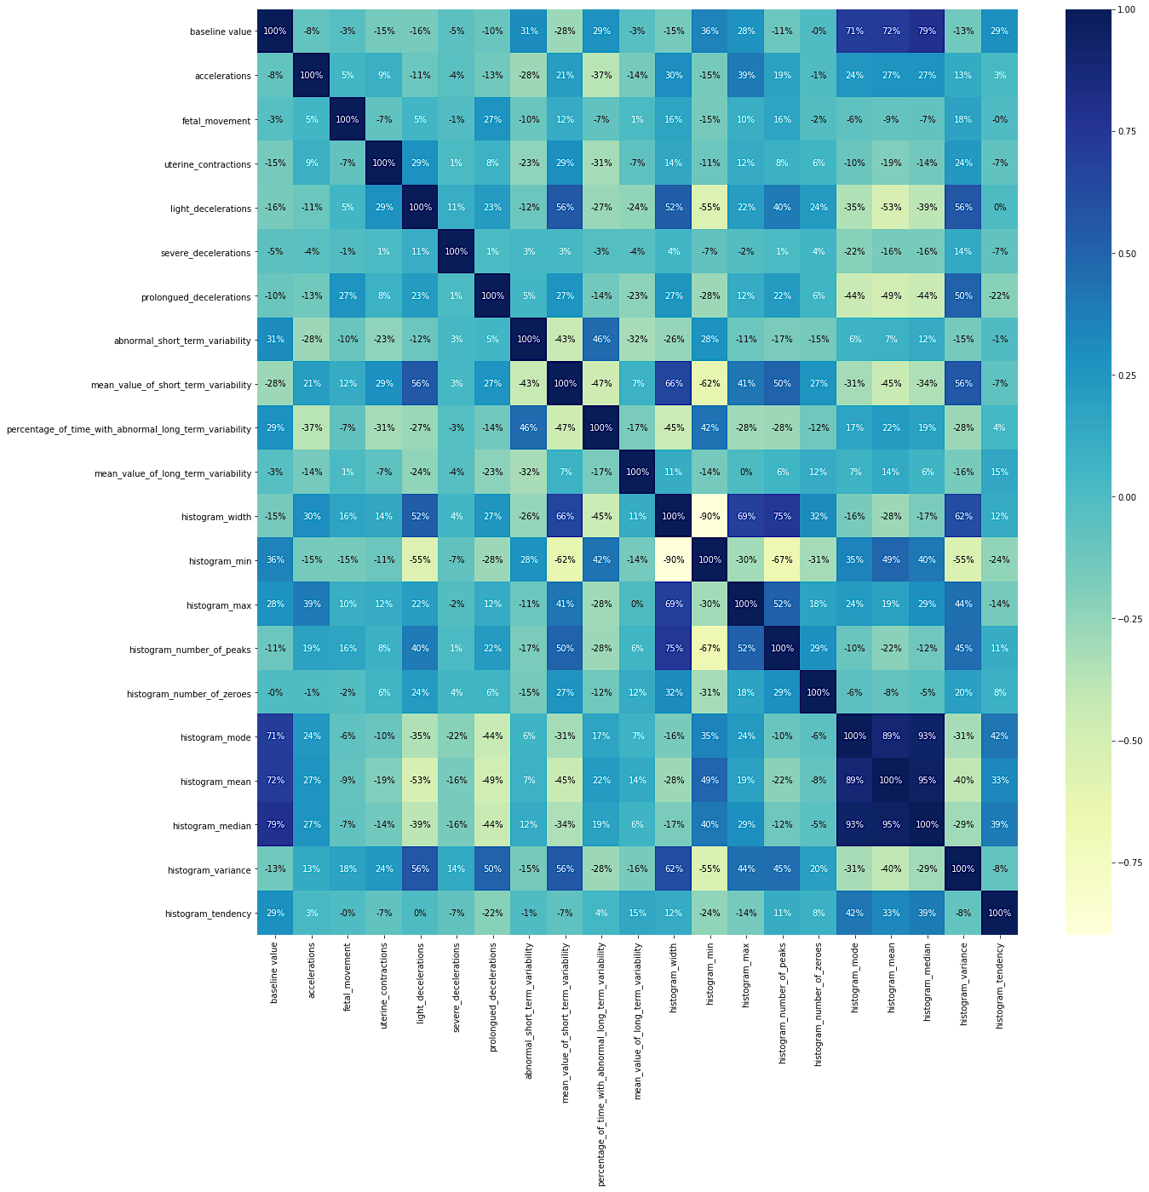
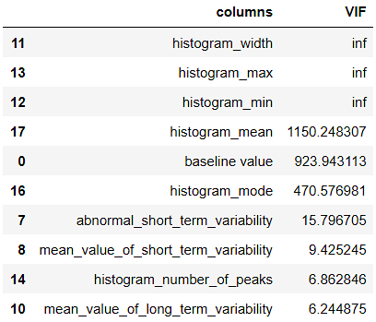
PRELIMINARY ANALYSIS
CORRELATION ANALYSIS
Highly correlated variables:
Light decelerations with mean short term variability, histogram width and variance
Histogram width, variance & max values
Histogram mean, mode and median along with baseline value
Key Takeaways from VIF:
Histogram width, max, min, mean, mode and baseline value seem to have very high VIF
Other variables associated to abnormal variability (short & long) also have VIF > 4

Slide 9
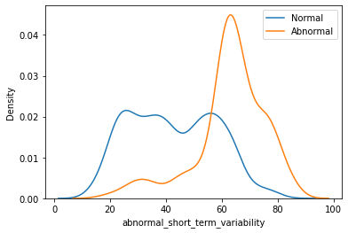
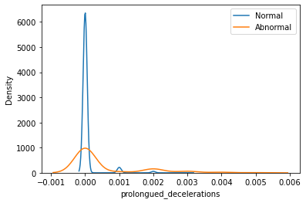
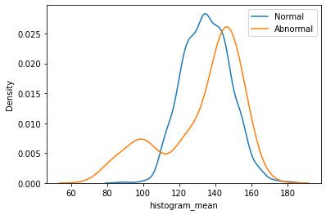
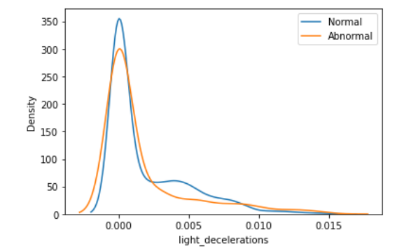
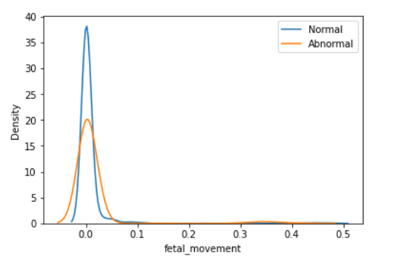
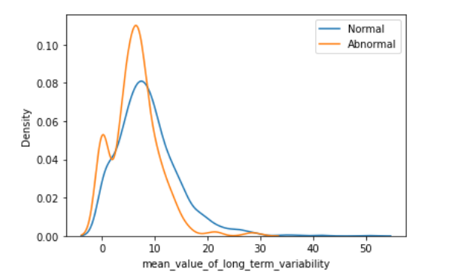
PRELIMINARY ANALYSIS
BIVARIATE ANALYSIS WRT FETAL HEALTH IDENTIFICATION
Key Takeaways:
First row variables show a clear demarcation for the normal and suspect cases
Other parameters do not show a clear demarcation for normal and suspect class

Slide 10
03
Modelling and
Predictions

Slide 11
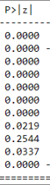
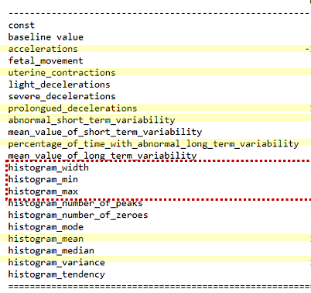
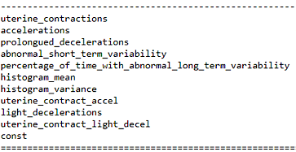
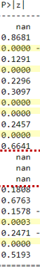
LOGISTIC REGRESSION
Step – 1
Run a logistic regression model with all the variables
Step – 2
Ran a logistic regression with significant variables and two interaction terms*
AIC | BIC | Pseudo R²
578.38 | 689.79 | 0.651
AIC | BIC | Pseudo R²
592 | 650 | 0.629
2
3
1
Highlights
Some variables are nan. Model was not able to solve for their coefficients
Model performance on Train data is not very great. However, BIC value has decreased (less complex model)
The interaction terms are significant indicating that the suspected interaction is indeed true
* Interaction Terms: uterine_contract_accel, and uterine_contract_light_decel

Slide 12
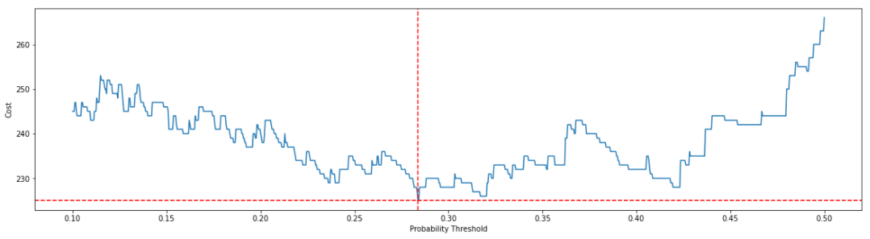
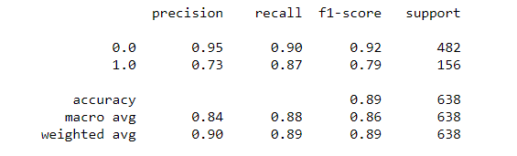
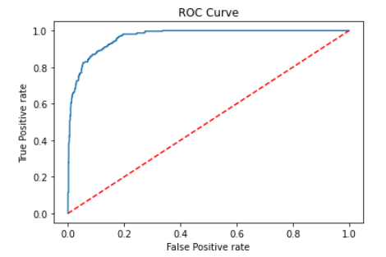
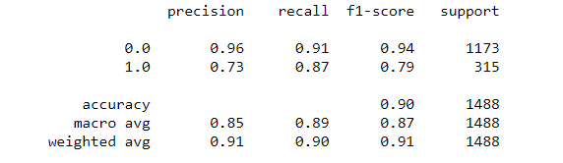
LOGISTIC REGRESSION
Step – 3
Identify the threshold probability cutoff and performance on Training Set
Step – 4
Assessing the performance on test data
We assumed the cost associated with FP:FN as 1 : 3
Classification Report
3
2
1
Highlights
Threshold that minimizes overall cost is 0.284
Accuracy in both train and test (~90%) is much better than baseline classifier (~77%)
The recall and precision for class 1 is not very good
2
AUC:0.965
Accuracy: 90%

Slide 13
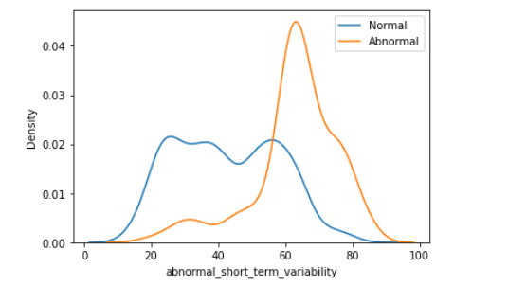
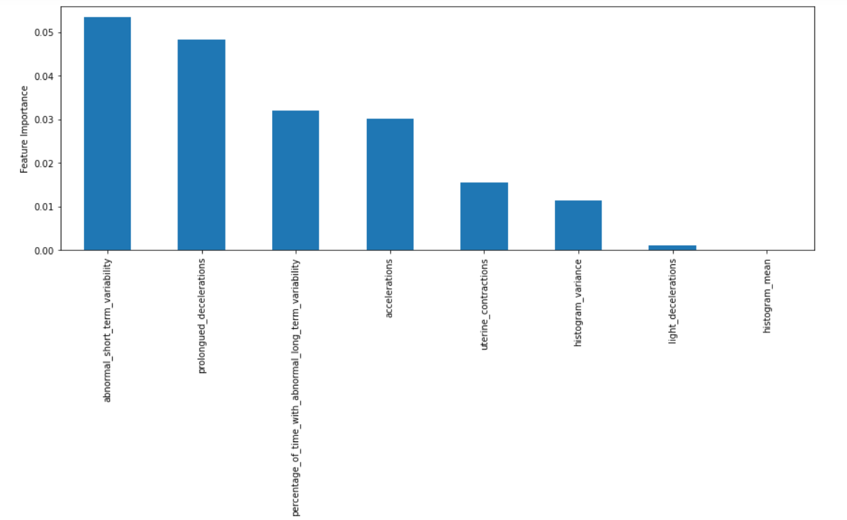
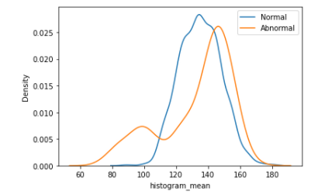
LOGISTIC REGRESSION
Feature Importance
Abnormal short term variability came out to be important as expected
Histogram mean were expected important but came out to be less important

Slide 14
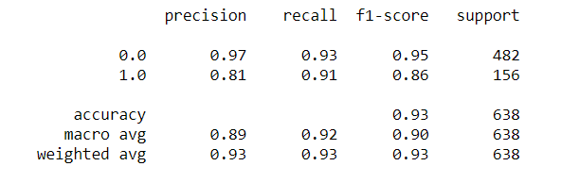
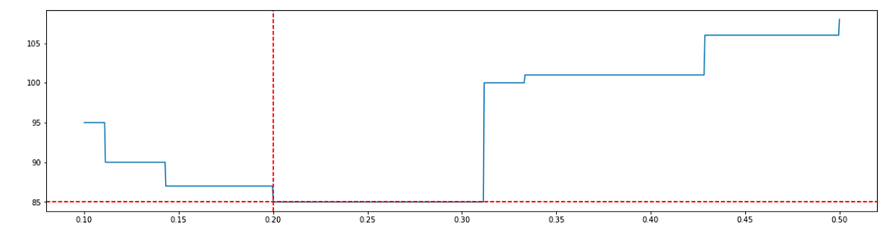
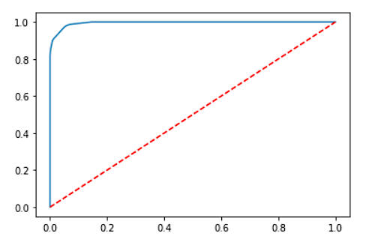
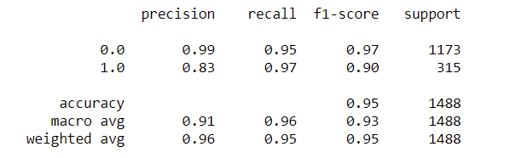
DECISION TREES
Performance on training set
We used Grid Search with cross validation to tune our model on training dataset Best model Parameters: (max_depth=7, min_samples_split=10)
Performance on test set
Classification Report
We assumed the cost associated with FP:FN as 1 : 3
3
2
1
Highlights
Threshold that minimizes overall cost is 0.20
Accuracy in both train and test (~93%) is much better than baseline classifier (~77%) and logistic regression
The recall and precision for class 1 is getting better
2
AUC:0.99
Accuracy: 95%

Slide 15
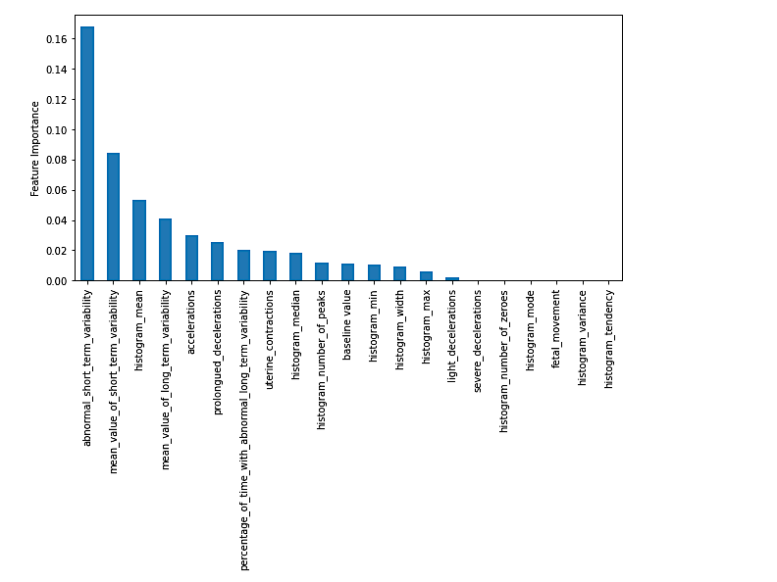
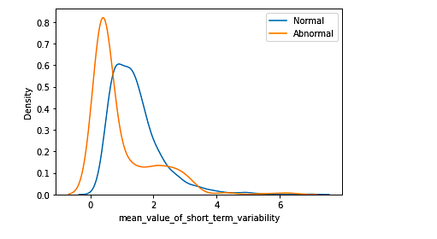
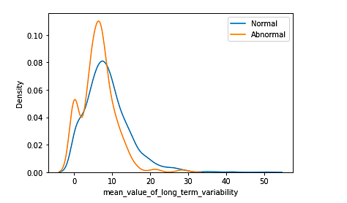
DECISION TREES
Feature Importance
Abnormal_short_term_variability consistently remains the most important feature.
Histogram Mean, which we anticipated should be an important feature is 3rd in row.
Mean value of short-term variability, also shows good differentiation between Normal and Abnormal and is at number-2 in the model (graph below)
2 out of top 5 variables are consistent in logistic and Decision Tree

Slide 16
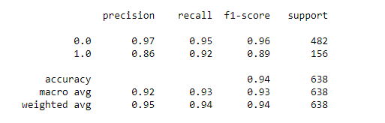
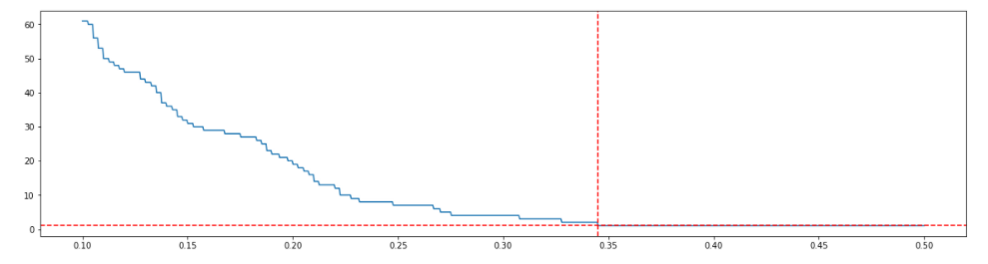
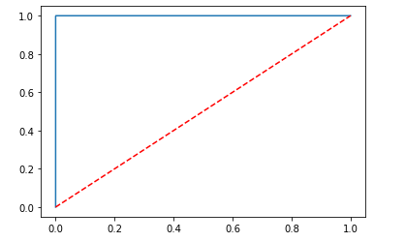
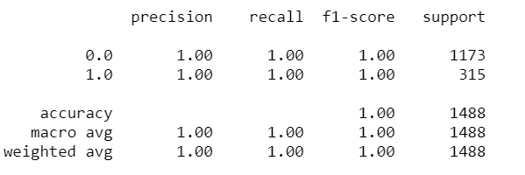
RANDOM FOREST
Performance on training set
We used Grid Search with cross validation to tune our model Best model Parameters: (criterion= 'gini', max_features=11, n_estimators = 400)
Performance on test set
Classification Report
We assumed the cost associated with FP:FN as 1 : 3
3
2
1
Highlights
Threshold that minimizes overall cost is 0.34
Accuracy in train set is 100% and in test set is 94%
The recall and precision for class 1 is even better than Decision Tree
2
AUC:0.99
Accuracy: 100%

Slide 17
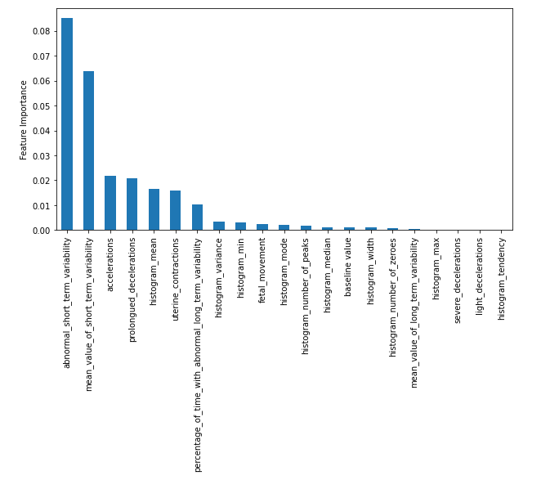
RANDOM FOREST
Feature Importance
Abnormal_short_term_variability consistently remains the most important feature
If we compare the top 5 features, they are roughly consistent with decision trees. However, as expected variable mean_value_of_long_term_variability is thrown out of the top 5 range
Other histogram attributes are consistently ranked lower which is consistent with EDA as they were correlated with histogram_mean

Slide 18

SUMMARY
Model Selection
Important Features
Parameter | Logistic | Decision Tree | Random Forest
Overall Accuracy | 89% | 93% | 94%
AUC | 0.965 | 0.99 | 0.99
For Class 1 in hold-out dataset i.e., Abnormal Fetus
Precision | 73% | 81% | 86%
Recall | 87% | 91% | 92%
F1 Score | 79% | 86% | 89%
Abnormal Short-Term Variability
Mean Value of Short-Term Variability
Acceleration
Prolonged Deceleration
Histogram Mean

Slide 19
03
Insights and
Implications

Slide 20
Insights and implications
HEART RATE VARIABILITY, ACCELERATIONS AND DECELERATIONS CAN BE MAJOR INDICATORS OF FETAL HEALTH
Factors with
maximum impact
Insights & suggestions
Further information & actions
Short term variability, accelerations and decelartions in fetal heart rate CTG seem to be major classifiers for suspect cases
Uterine contractions and long-term variability in heart rate can also be monitored
Diagnosis of fetal distress in the 3rd trimester can be categorized based on these parameters
Anomalies in these particular metrics could be prioritized for medical help in regions with lesser resources
Inclusion of more cases based on separate deographics might lead to better predictions and forecasting globally
Coupled with other attributes such as maternal health and lifestyle, genetic buildup, anomalies could be forecasted way earlier

Slide 21
Thank you!
Aug 2021

Slide 22
APPENDIX

Slide 23
WHAT DO WE WANT
F(baseline value, acceleration, uterine contractions, light decelerations, …….) = P(fetus is Abnormal)
How are we doing it?
Parametric Model
Non-Parametric Model
Logistic Regression
Decision Trees
Random Forest

Slide 24
MODELLING METHODOLOGY
Final Model
Test Data
Full Data
Final Model with:
Model Construct
Threshold
Y | X1 | X2
Evaluate Performance on Final Model
Y | X1 | X2
Train Data
Model Tuning
Selecting Threshold
Y | X1 | X2
Hyperparameter Tuning to select best model construct using cross validation
False Positive : Normal Predicted as Abnormal
False Negative: Abnormal Predicted as Normal
We use cost-based approach to penalize FNs more than FPs

Slide 25
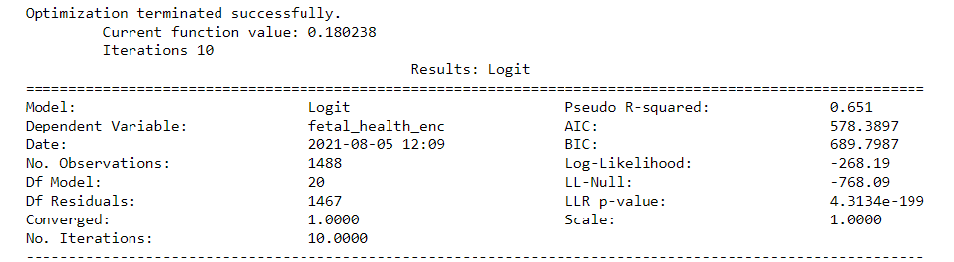
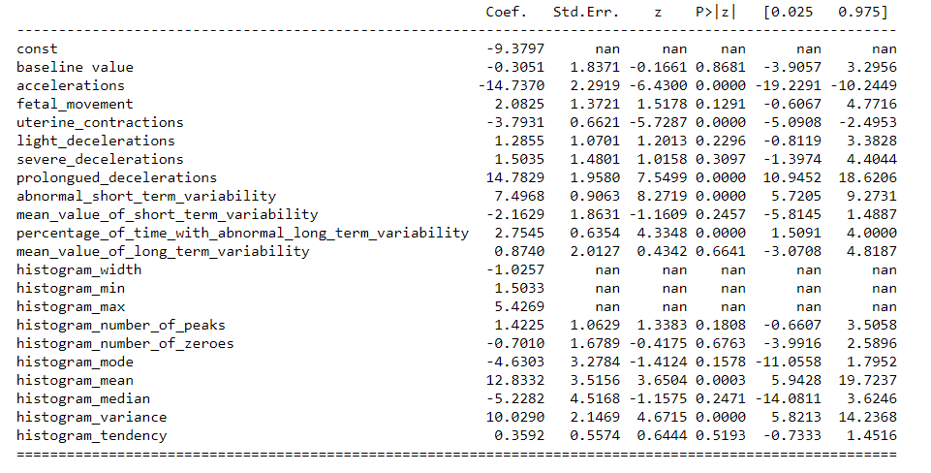
LOGISTIC REGRESSION
Step - 1
Run a logistic regression model with all the variables
Insight Box
Model performance on Train data is not very great. Pseudo R^2 = 65%
Some variables are nan. Model was not able to solve for their coefficients
Only a few variables are statistically significant indicating that not all variables have impact on prediction variable

Slide 26
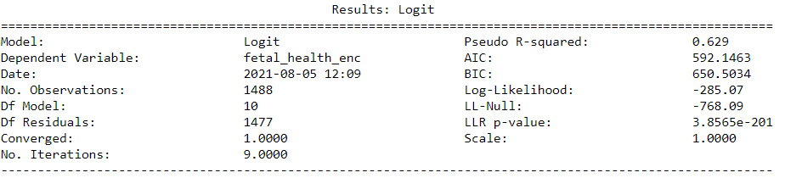
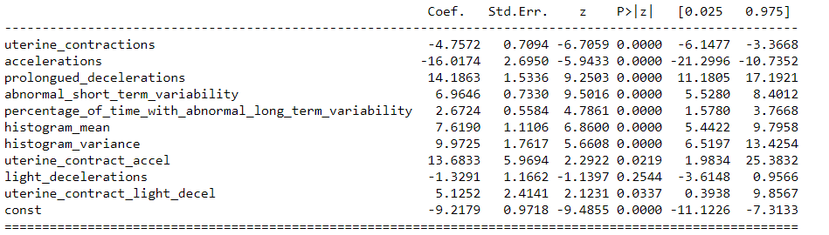
LOGISTIC REGRESSION
Step - 2
Ran a logistic regression with significant variables and two interaction terms*
Insight Box
Model performance on Train data is still not very great. However, when compared to previous model, BIC value has decreased (less complex model)
The interaction terms are significant indicating that the suspected interaction is indeed true
* Interaction Terms: uterine_contract_accel, and uterine_contract_light_decel

Slide 27
LOGISTIC REGRESSION
Step - 3
We assumed the cost associated with FP:FN as 1 : 3
Identify the threshold probability cutoff and performance on Training Set
Insight Box
Threshold that minimizes overall cost is 0.284
Area under the curve is good : 96.5%
Accuracy is much better than baseline classifier (90%)
The precision of class ‘1’ is low
AUC:0.965
Accuracy: 90%

Slide 28
LOGISTIC REGRESSION
Step - 4
Assessing the performance on test data
Insight Box
Similar performance as on test set indicating that the model is not overfitting the train data

Slide 29
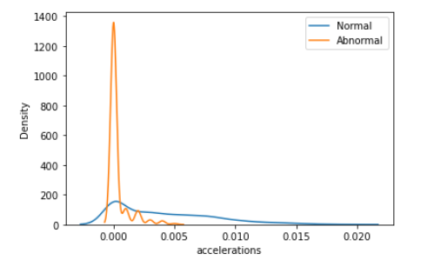
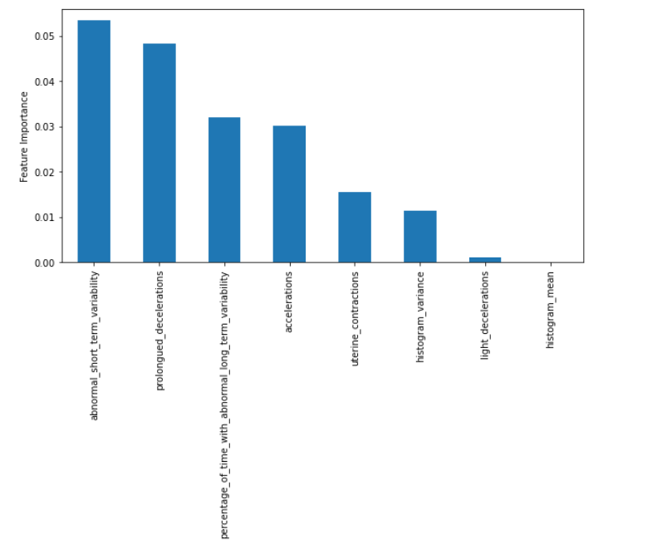
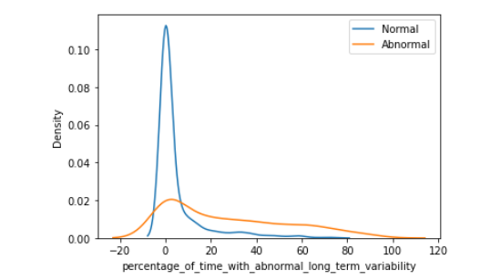
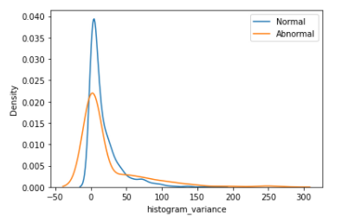
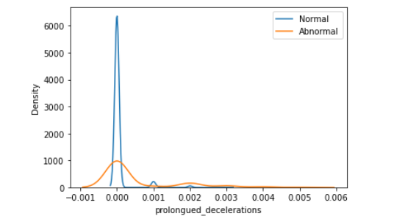
LOGISTIC REGRESSION
Feature Importance

Slide 30
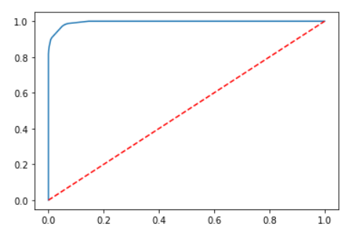
DECISION TREES
Model Performance
Performance on Training Data
Performance on Test Data
AUC:0.99

Slide 31
RANDOM FOREST
Model Performance
Performance on Training Data
Performance on Test Data
AUC:0.99

